Slide 1


Safer Internet Day 2022
All Fun and Games?

Slide 2

All fun and games? Exploring respect and relationships online
Exploring respect and relationships online
Together for a better internet
Notes:
There is no escaping the internet - how to use it safely
KS1 - looking at apps and in app purchases.
KS2 talking about online relationships and being respectful online.

Slide 3









What do our children do online?
Gaming

Slide 4


Age Ratings
 | (parental controls strongly recommended for under 13’s)
 | Some parents believe 10 is a better age.
Notes:
Roblox can be set up to play on a private server only with friends

Slide 5





What do our children do online?
Social

Slide 6


Age Ratings
YouTube | No PEGI rating to watch videos. You need to be 13 to have your own YouTube channel. However, children could easily access unsuitable videos.
YouTube Kids | Is suitable for under 13’s
TikTok
Instagram
Whatsapp
Notes:
With the exception of youTube all of these apps are unsuitable for primary children. We are not teaching children how to be safe on these apps.

Slide 7
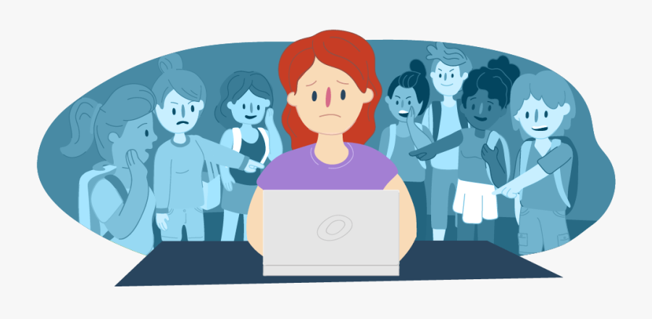
Online safety issues for primary children
Friends being unkind to each other online.
Children watching material that is age inappropriate.
Fake/misinformation.
Screen time.
Online reputation.
Online grooming.
Notes:
There are lots of risks on the internet for children, however the most common problems that we are told about at school are: Unkind behaviour - ganging up on me in a game, ‘scamming’ hacking into account and taking my virtual money.
People being unkind - friends and ‘random’ people.
Online grooming gets lots of news attention but it is a rare occurrence and we do

Slide 8

Our message to the children
KS1
Enjoy being online.
Always be kind and respectful to others.
Talk to a trusted grown up if you have any problems.
Make safe choices - keep private information private.
Remember that it is OK to say no to people you meet online
Notes:
If KS1 children are only accessing age appropriate sites their risks are very low.
Talk to a trusted grown up about anything that goes wring - including pop ups, requests for purchases etc.

Slide 9
Our message to the children
KS2
Be a kind a respectful friend online.
Stay alert to dangers - keep your passwords safe, keep information private, do not click on unknown links.
Challenge the behaviour - ‘that is unkind’ ‘I don’t like that’
No means no - respect other people’s boundaries
Stand up for your friends
Use the safety tools such as block/unfriend/report and screen shot.
Talk to a trusted adult

Slide 10
How can you support your child?
As a parent or carer you play a key role in helping your child to stay safe online.
Have conversations with children about their online life. Find out about what they enjoy doing and go online together. Let your children know you are there to support them.
Talk about what they have learnt at school about e-safety and reinforce the e-safety messages.
Research their favourite games and apps so you know what they involve.
Use safety features and parental controls. Google, Microsoft, Apple and Playstation all have parental controls. Do your children know how to use the safety features of different apps?
Model expected behaviour and link face to face interactions to online ones. Children learn how to interact in person from adults. We need to model how to behave online as well.

Slide 11

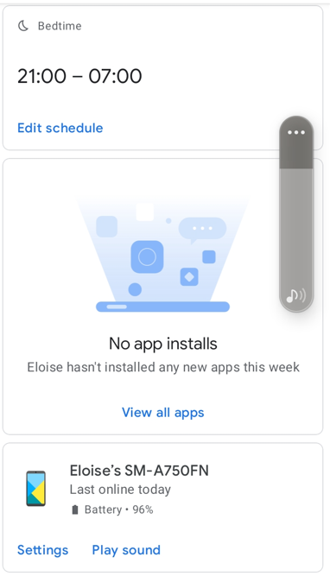
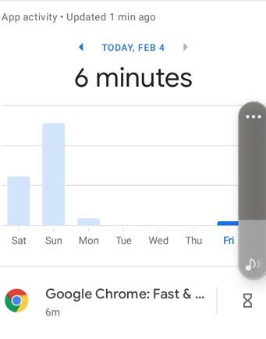
Google family link
Control the time children spend online.
Create child email addresses
Control what children are able to download
See your child’s usage.
Works on Android, Apple and PC

Slide 12


Child Friendly Search Engines.

