Slide 1
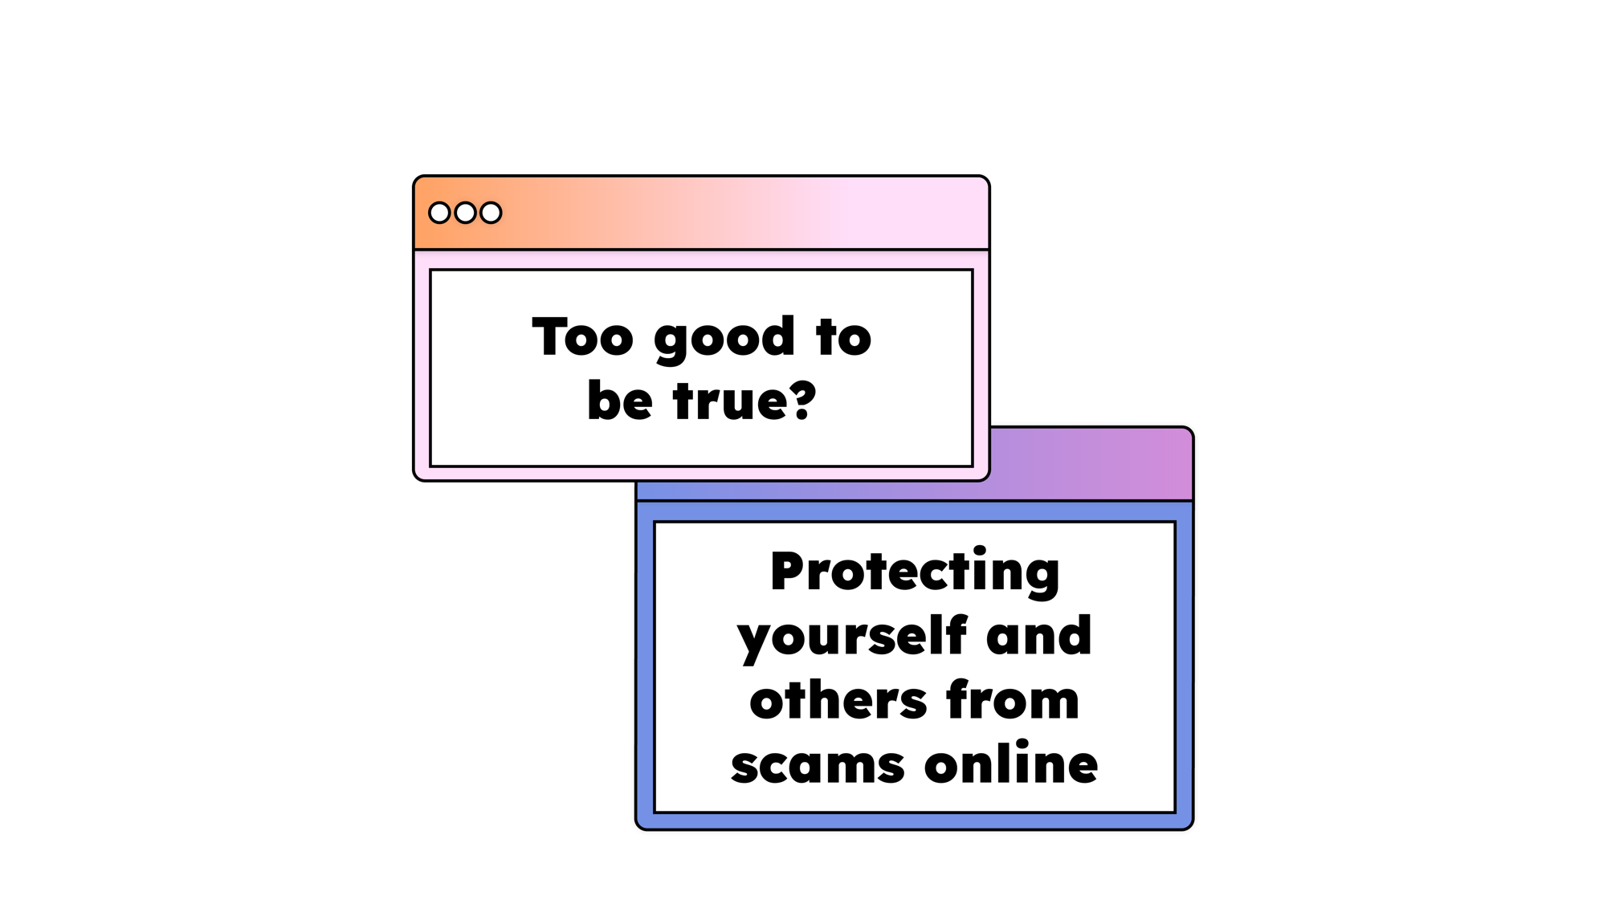



Safer Internet Day 2025
Notes:
Safer Internet Day is the UK’s biggest celebration of online safety. Each year the UK Safer Internet Centre covers an online issue or theme that speaks about the things young people are seeing and experiencing online. Created in consultation with young people across the UK, this year Safer Internet Day will be focusing on the issue of scams online and for young people, how to protect themselves and others, as well as what support is available to them.

Slide 2


AIMS
What are the signs of a scam?
Is the information reliable?
How can I protect myself from scams?
What can I do if I am unsure/think I’ve been scammed?
Top tips for adults
Notes:
In e-safety assemblies this week the children have been told about how to identify scams and consider if the information they can see is reliable. They have also considered how they can protect themselves from scams and what they can do if they are a victim of a scam. The first part of this presentation covers the information we have given to your children, the second part is about how we, their adults, can help to protect them from scams.

Slide 3


Slide 4
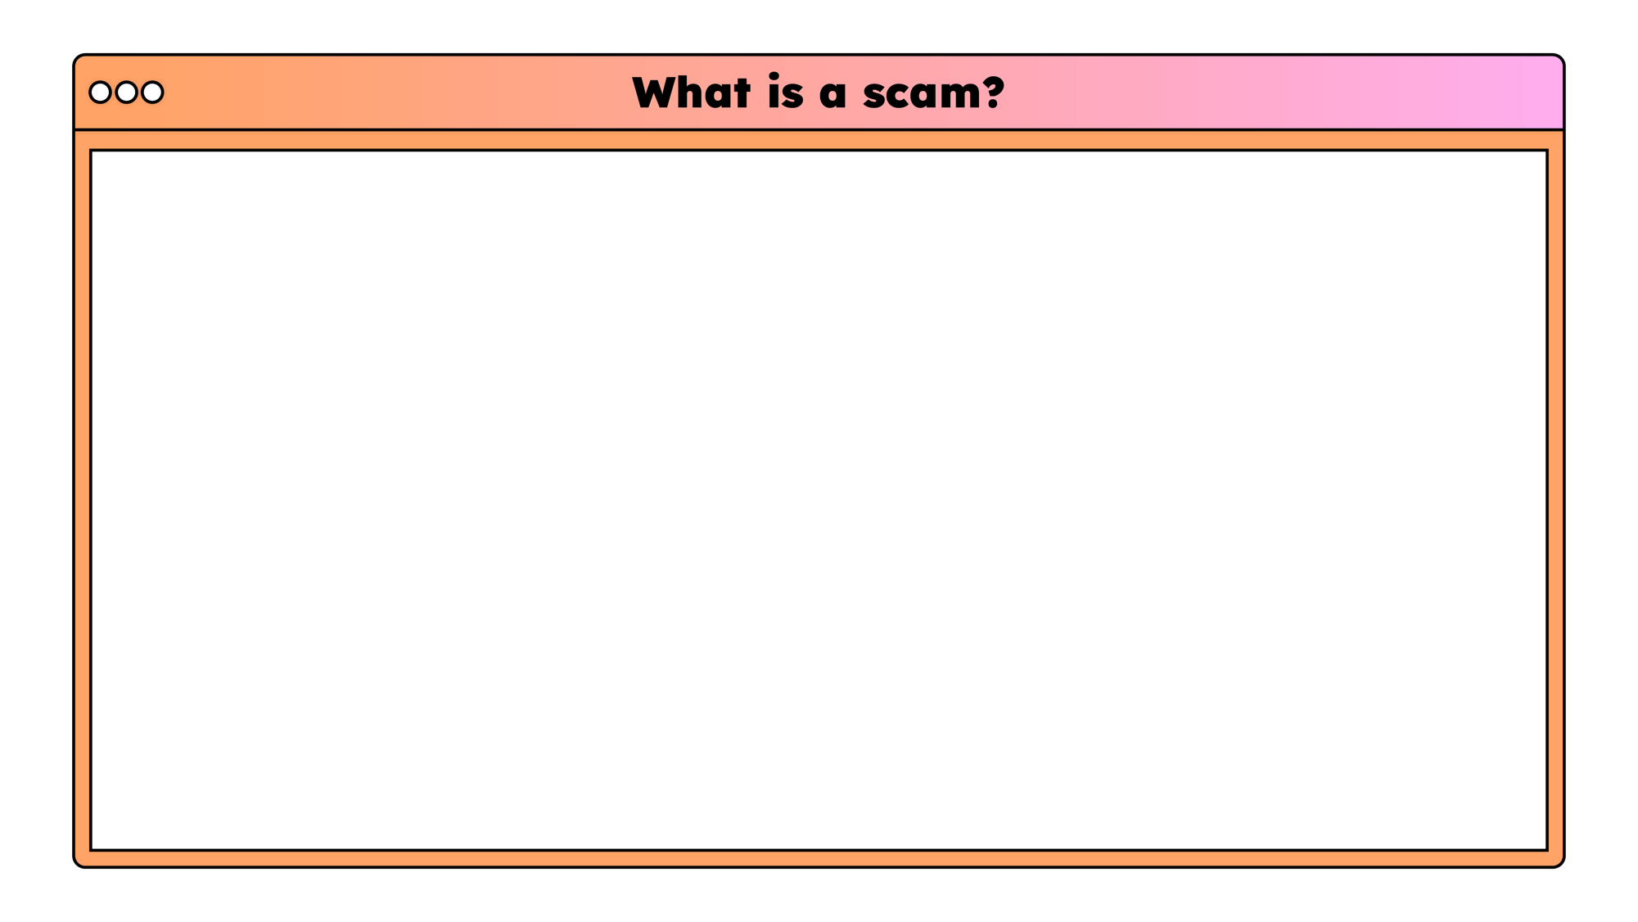

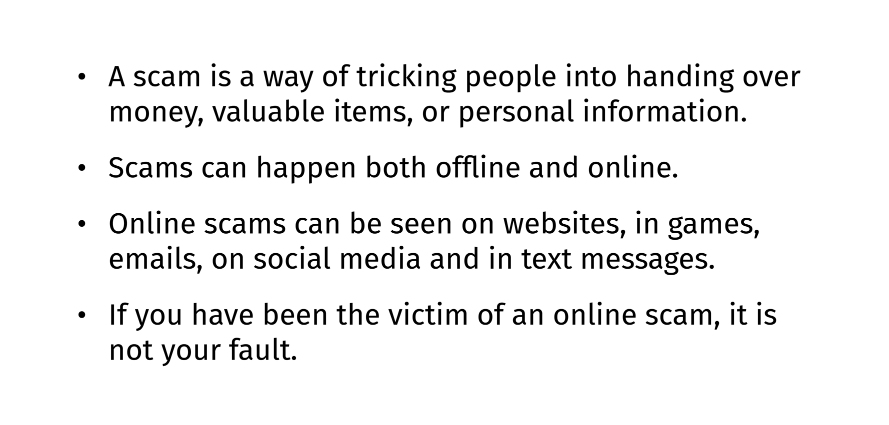
Notes:
You might think that young children are not at risk of scams. When you think of a scam you may immediately think of a romance scam or someone being tricked out of their life savings. However, think about how your child accesses the internet, what they do online and what kind of scams they could see as a result.
Do they use your computer or phone? Do they have their own phone or tablet? Is your information on the device they use?

Slide 5
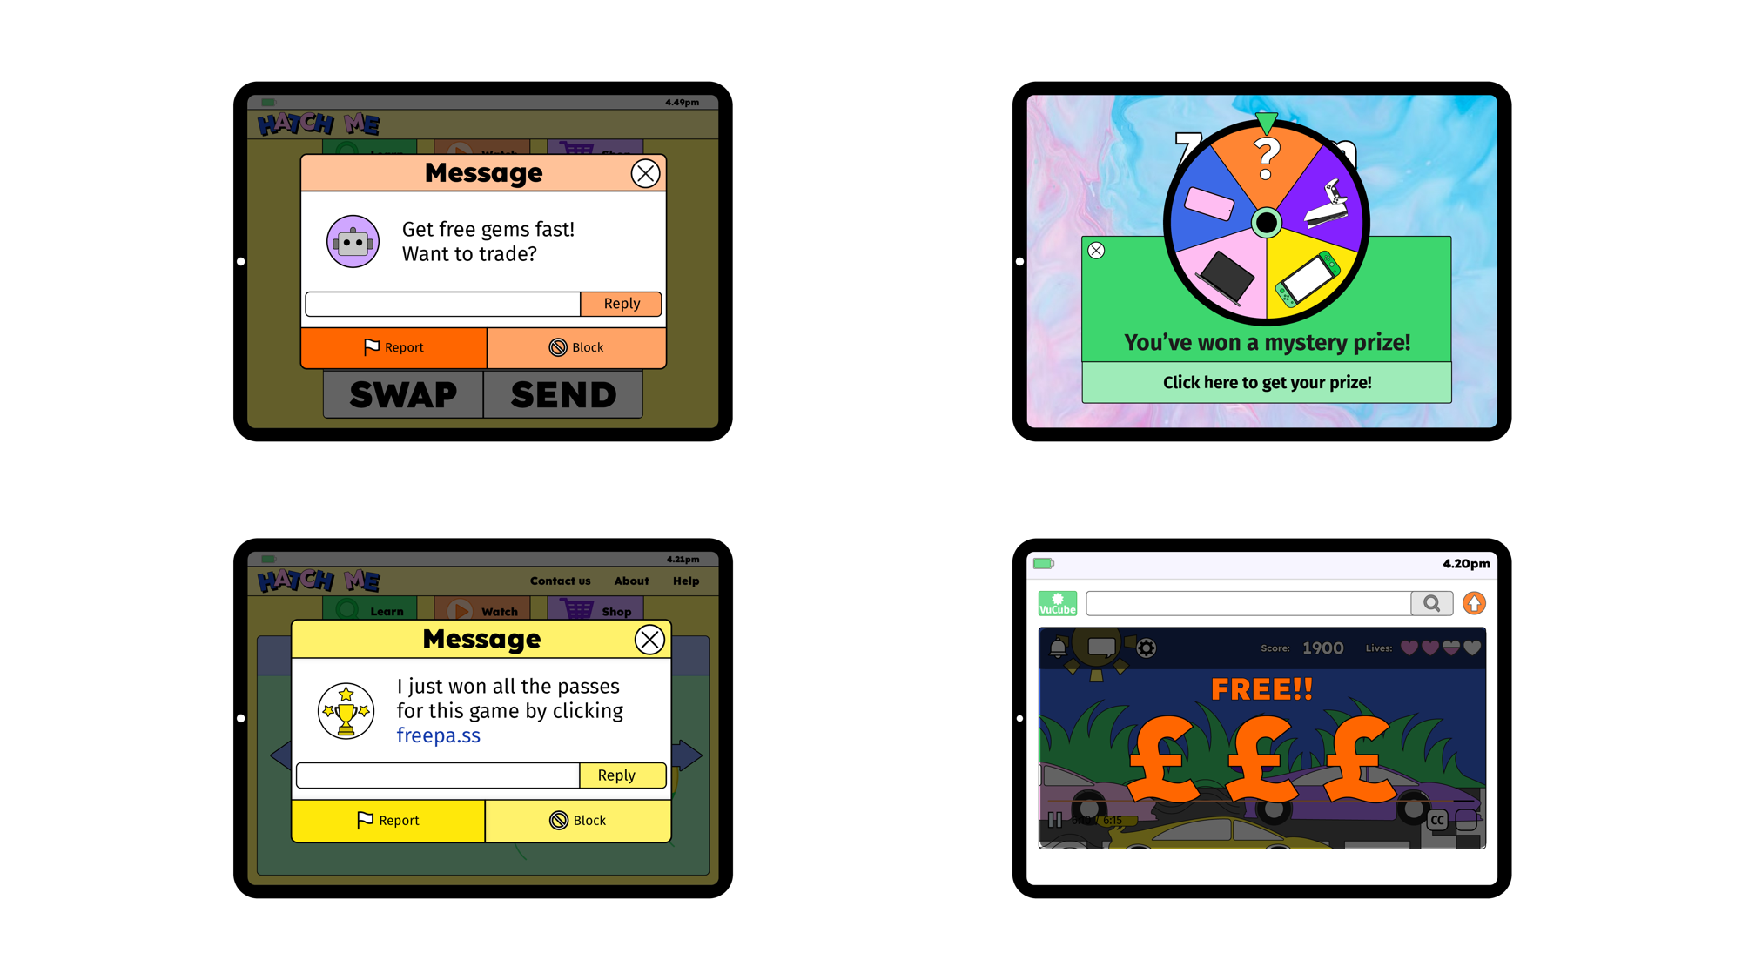


Slide 6

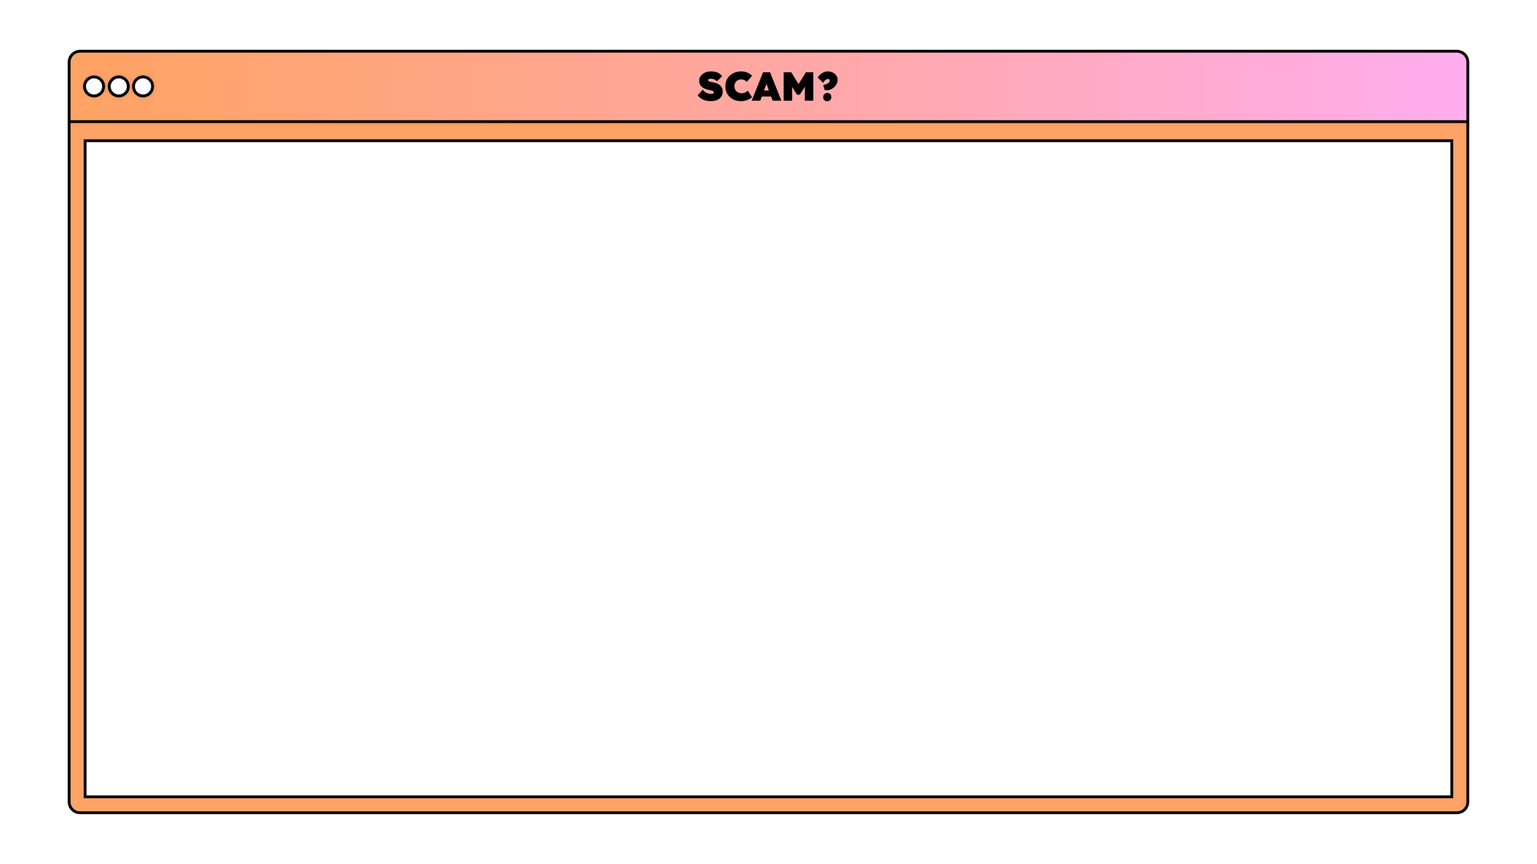



Notes:
Seems too good to be true – children see messages promising free in game currency, promises to unlock characters and equipment in games. They may be invited to trade outside of the game and tempted with a good offer.
Contact – How can your child be contacted while online? Do they see a lot of pop ups in the kind of games they play?
Personal information – Your child may not have an email address but does your email autofill on the device they use?
Money – What is valuable to your child that they could trade online?

Slide 7

How can I protect myself?

Slide 8
Tell a trusted adult if something isn’t right
Notes:
This is the primary and first e-safety message we give to children – from Reception up. If something does not feel right, look right or you don’t know what to do tell a trusted adult. We work with the children to identify who their trusted adults are in different situations. For example, if they see something pop up on a site at school they should talk to the teacher/TA they are with at the time. If they see something at home, they should talk to the adult they are with at the time. .

Slide 9
Look for the signs of a scam.
Notes:
In safety lessons we talk to children about the difference between facts, opinions and untrue information. They are given different scenarios to assess to decide if they are reliable. Children should talk to their trusted adult about what they have seen online.

Slide 10
Protect personal information
Notes:
Another theme we teach children in safety lessons in general is the importance of not sharing personal information and reducing their digital footprints.

Slide 11
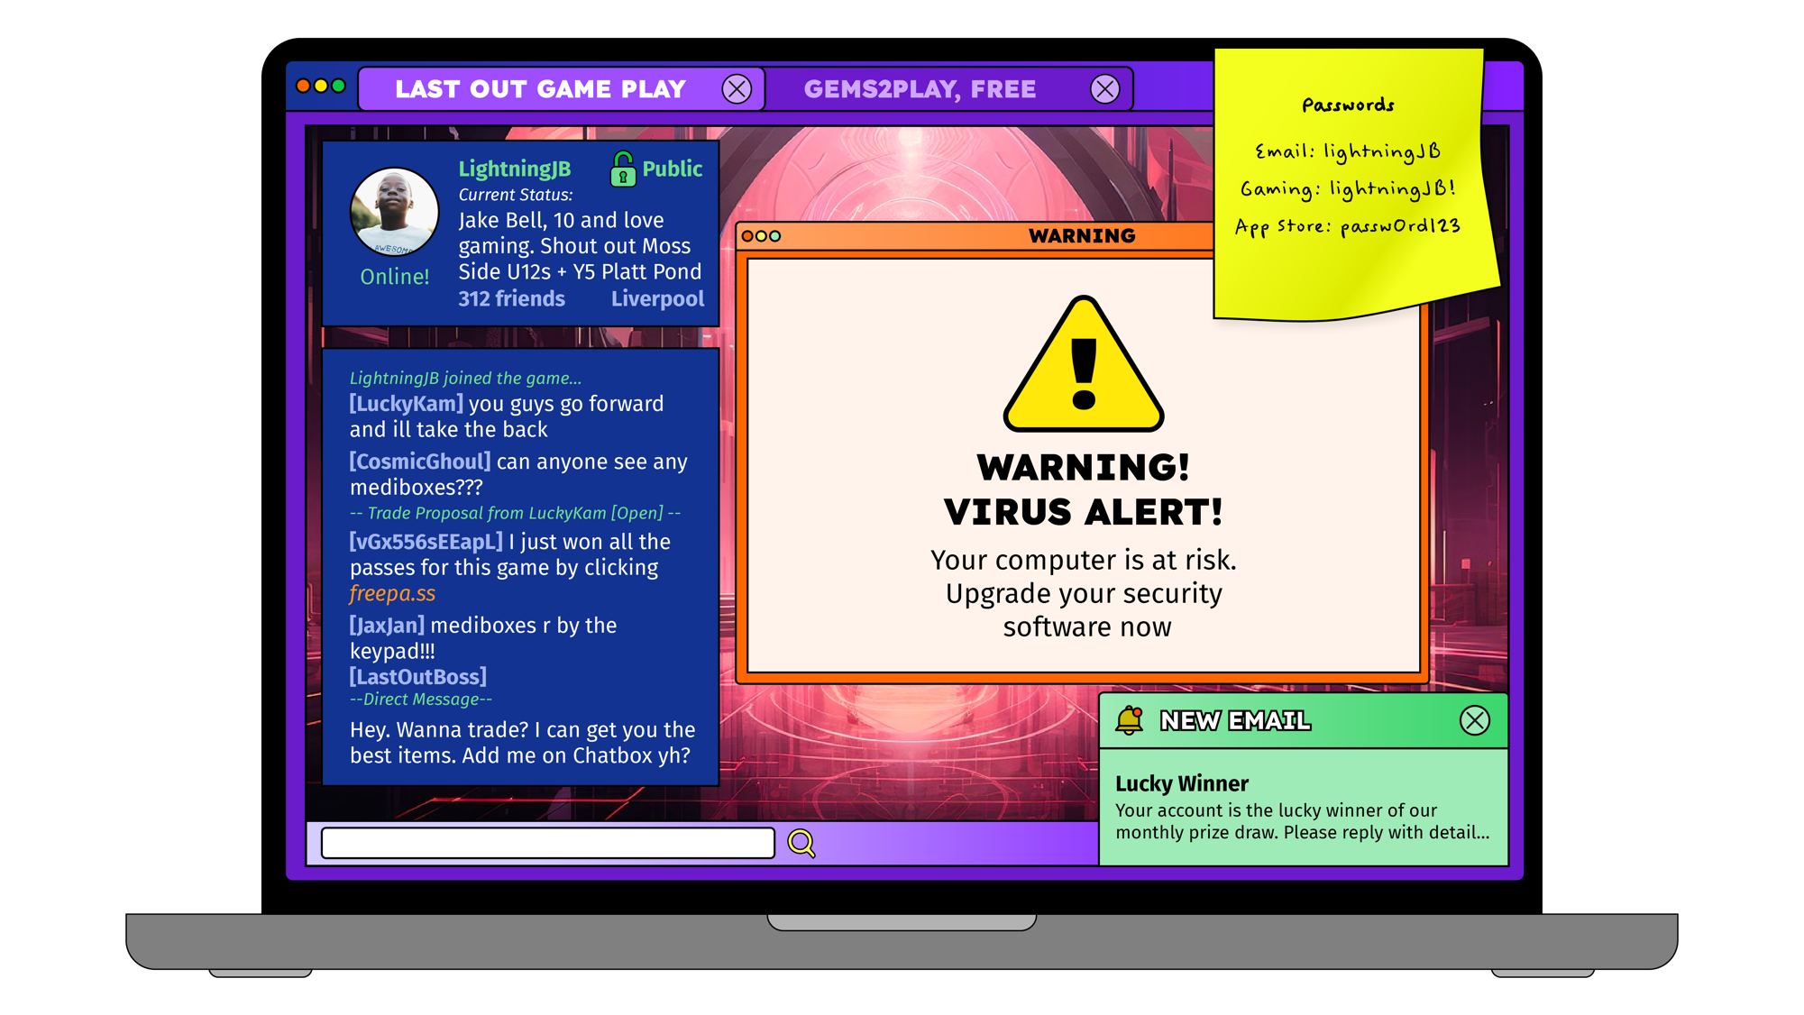



Slide 12




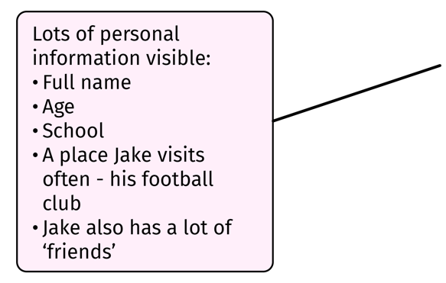

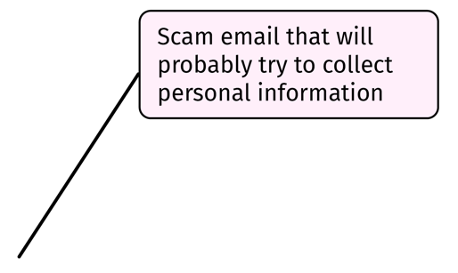
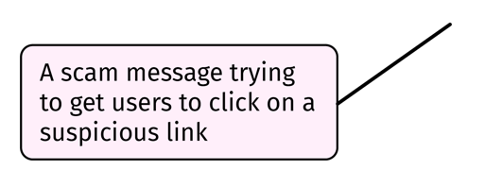
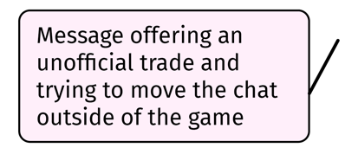

Slide 13

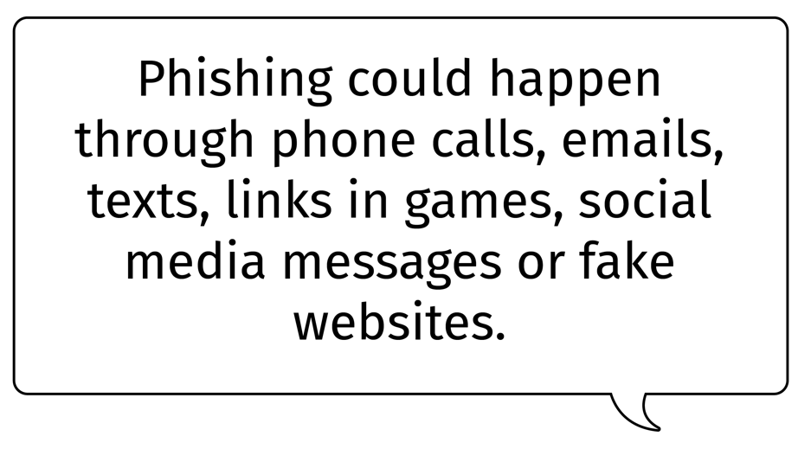
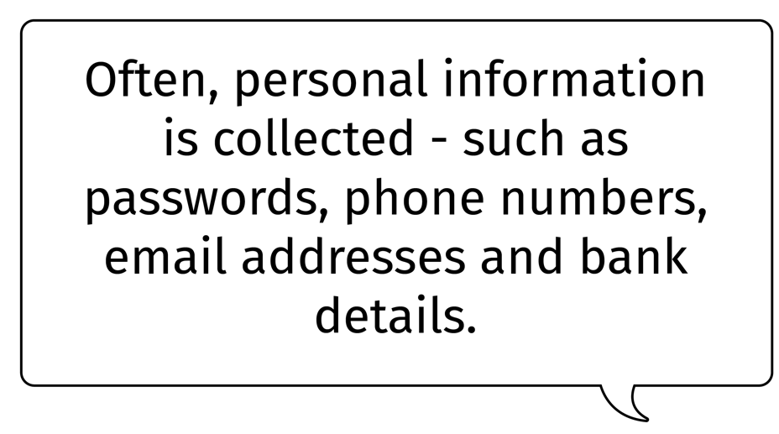

Notes:
Think about how your child may be asked for information online. Primary school children should not be on social media – most have a minimum age of 12 or older.

Slide 14
What can I do if I have been scammed?

Slide 15
Remember it is not your fault.
Talk to one of your trusted adults.
Take appropriate action – collect evidence, report and block.

Slide 16
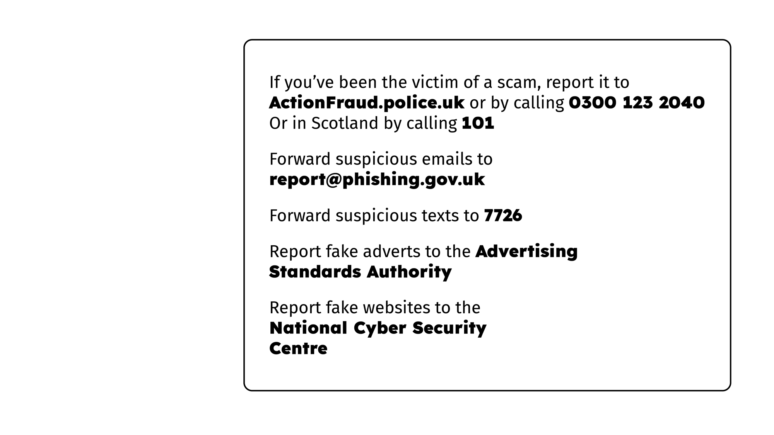
Many platforms have their own reporting processes.
For example, Roblox, Xbox, PlayStation and Nintendo

Slide 17
Top tips for adults

Slide 18
Enjoy going online together and talk regularly about your family’s online lives
The internet is amazing and can help us all to access information and entertainment. Spend time online with your child to understand how they are using technology and talk together about the good and the bad parts of being online. Talk about your own experiences and find other opportunities to get the conversation started, like stories in the news. Make sure your child knows they can talk to you about anything that they see or experience online.

Slide 19
Explain that not everything online is true
If your child is too young to understand what fraud is, you can still lay the groundwork to help them stay safe online as they grow. Start simple and talk about the difference between real and make believe. Help them recognise that not everything online is true and that some things they see or hear could be stories, jokes or tricks.

Slide 20
Make use of settings, especially relating to online purchases
Parental controls and other safety settings can help protect your child from online harms, including scams. To avoid any nasty surprises on your bank statement, make sure in-app purchases or new downloads require a passcode, and don’t set card details to autofill on devices your child has access to.

Slide 21
Look out for warning signs that someone or something online cannot be trusted
“It just seems too good to be true!” – Other common signs of a scam include contact that you weren’t expecting or being asked for money or personal information (think: bank or contact details, passwords, or phone numbers). Scammers use other tactics to manipulate their victims into paying, like playing with your emotions, or building a sense of urgency so you are rushed into making a decision. If you aren’t sure it’s reliable, don’t risk it.

Slide 22
Check the age rating on games and other online content
Sites and content aimed at young children had lots of protection built in. If children are accessing content for older children or adults they are exposed to more risks. Young children are still developing the skills they need to protect themselves.

Slide 23
Remember that anyone can be a victim of a scam
Scammers are good at what they do and will target anyone. We all need to stay vigilant and support those who are most vulnerable including children and the elderly by helping them recognise what to look out for. If anyone in your family has been scammed, talk openly about it. There should be no shame in being victim to a scam and it’s never your fault.

Slide 24

https://www.internetmatters.org/parental-controls/?paged=1

