Slide 1
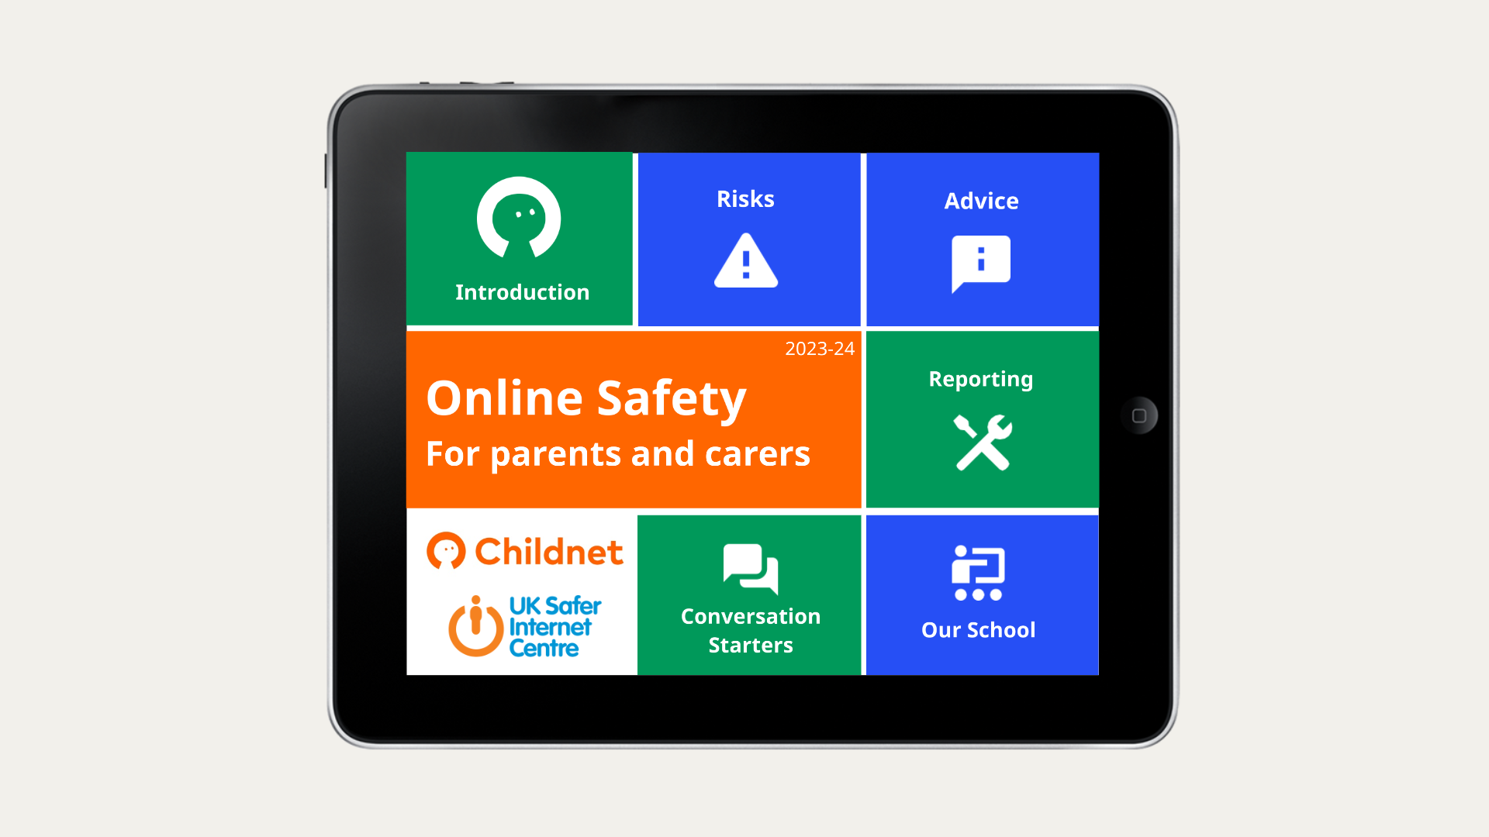

Slide 2
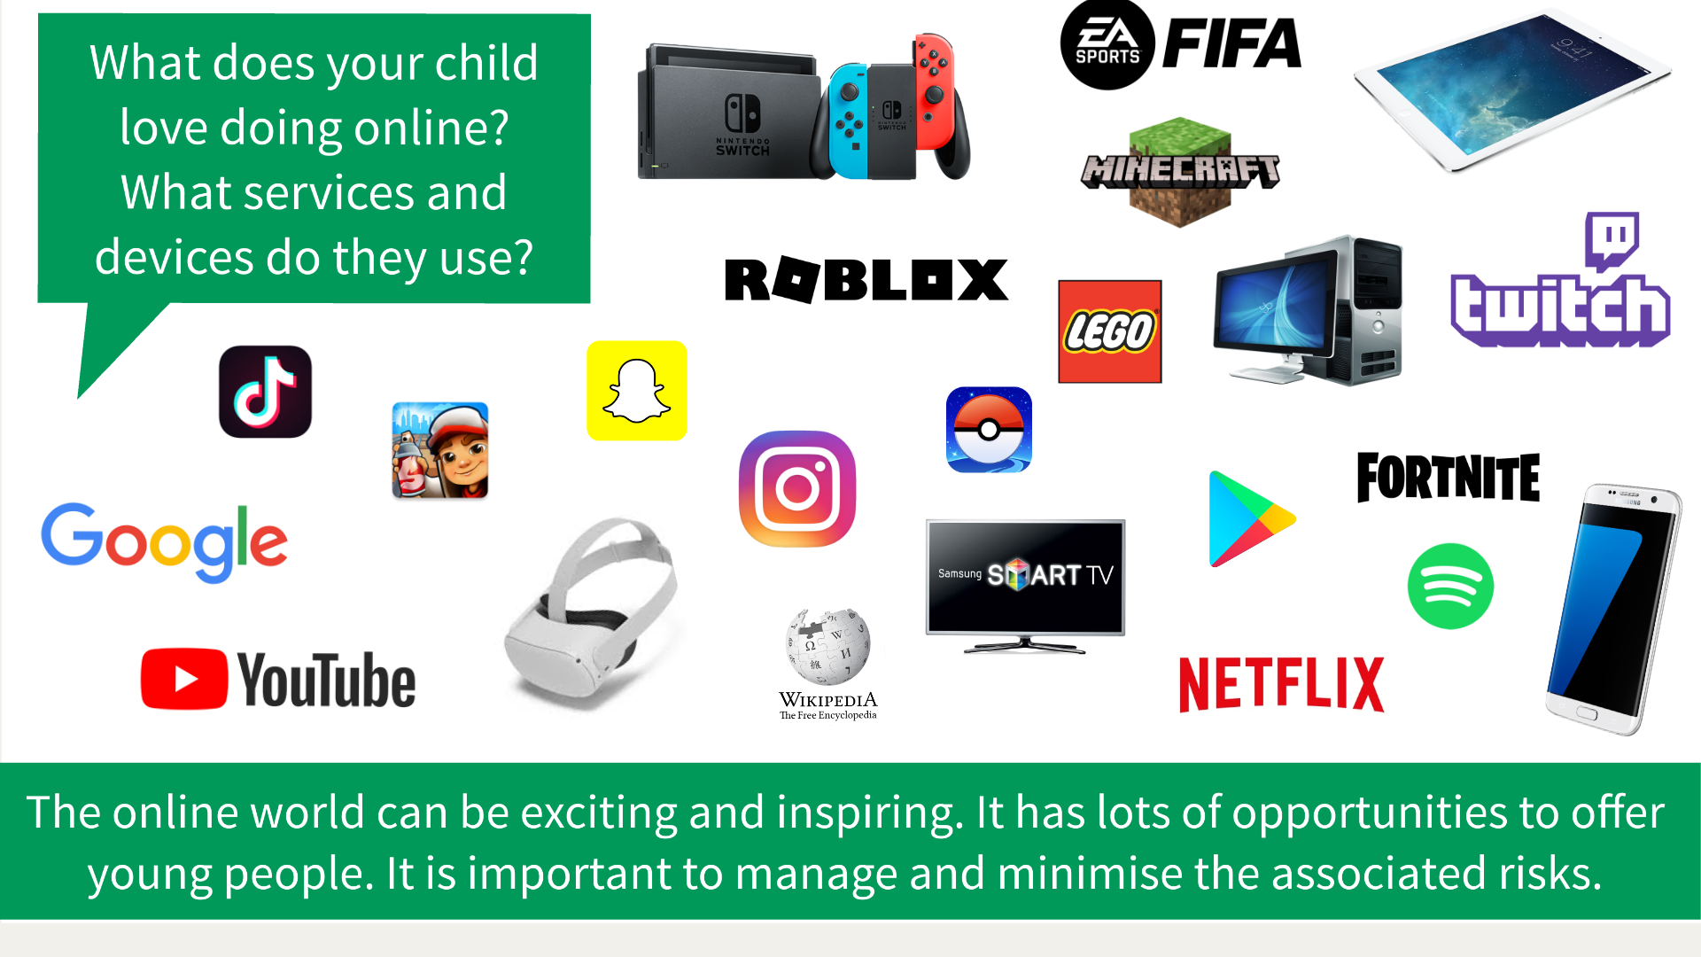

Slide 3
Risk

Slide 4



The 3 Cs
Conduct
Content
Contact

Slide 5
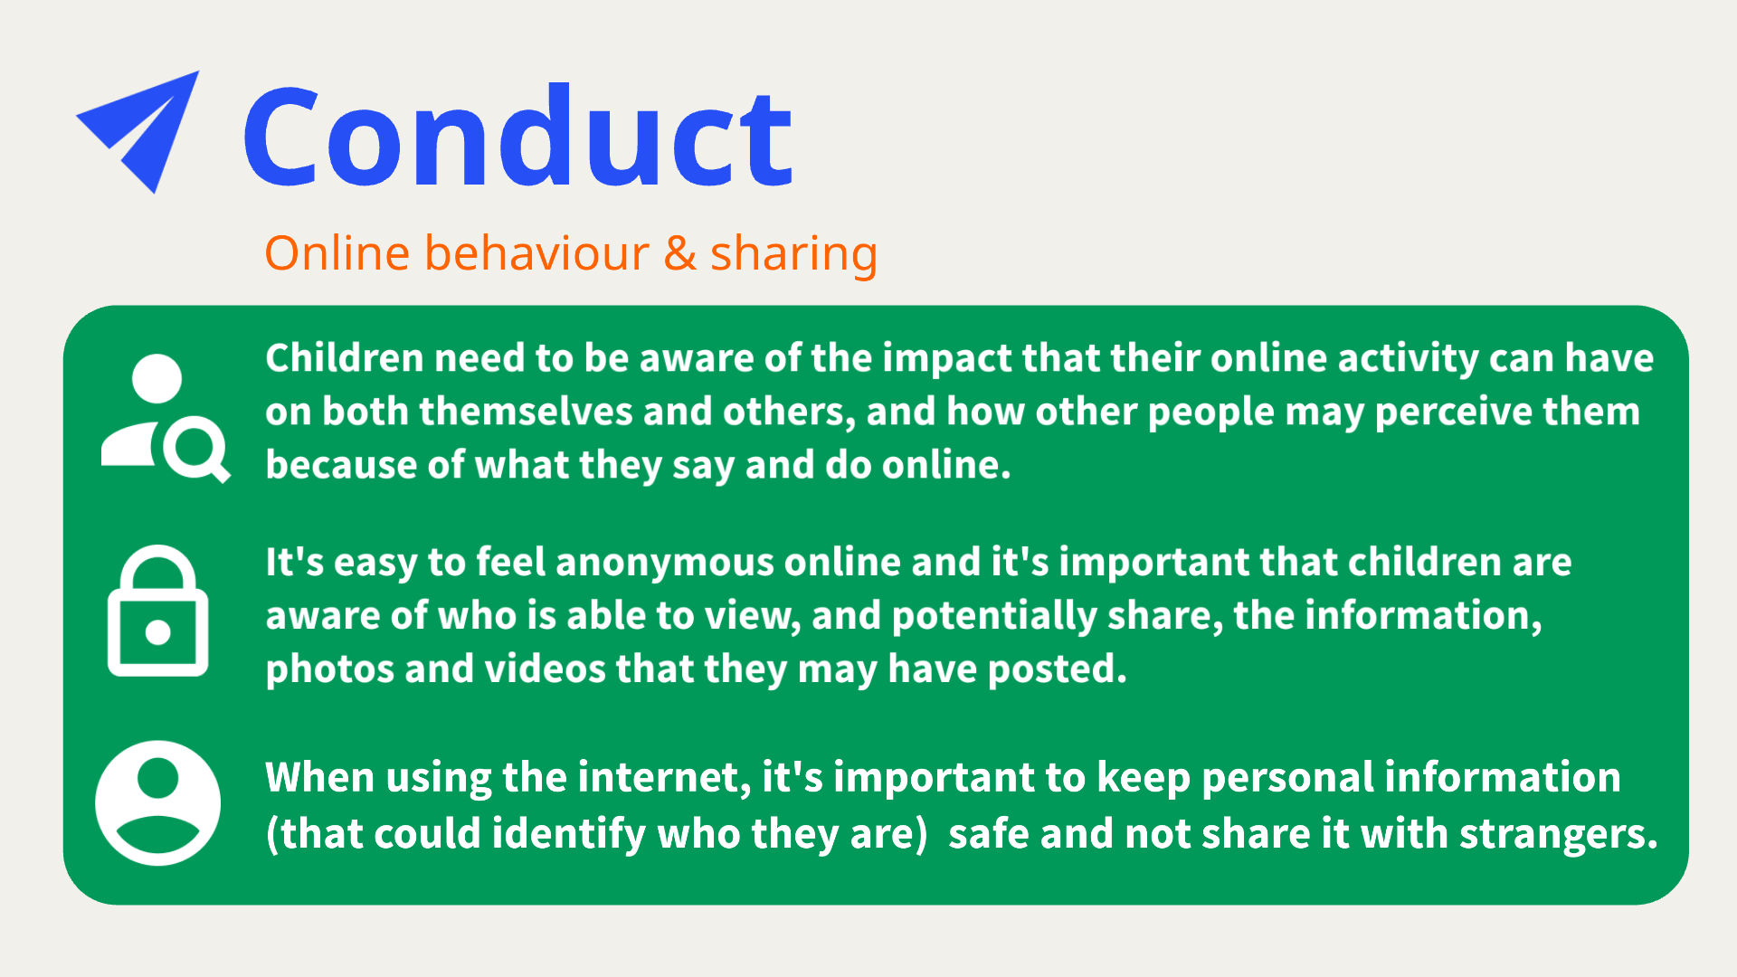

Slide 6
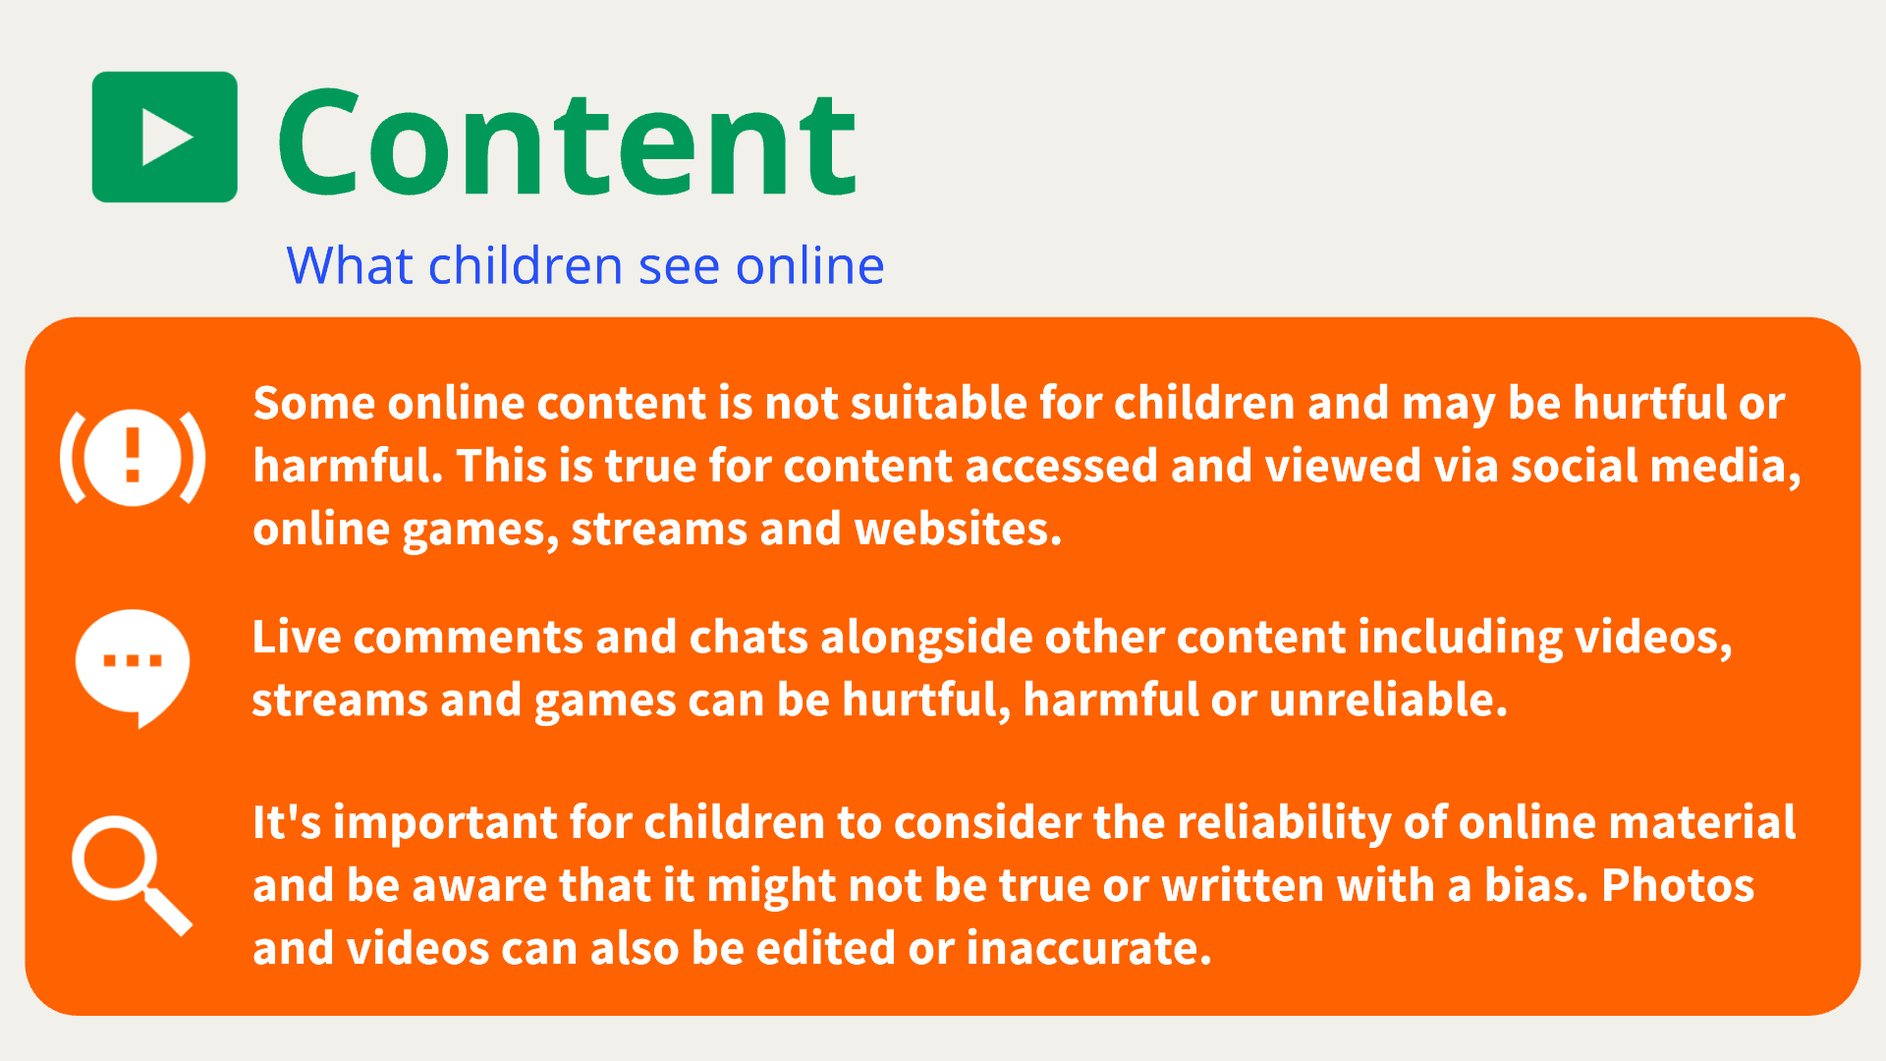

Slide 7
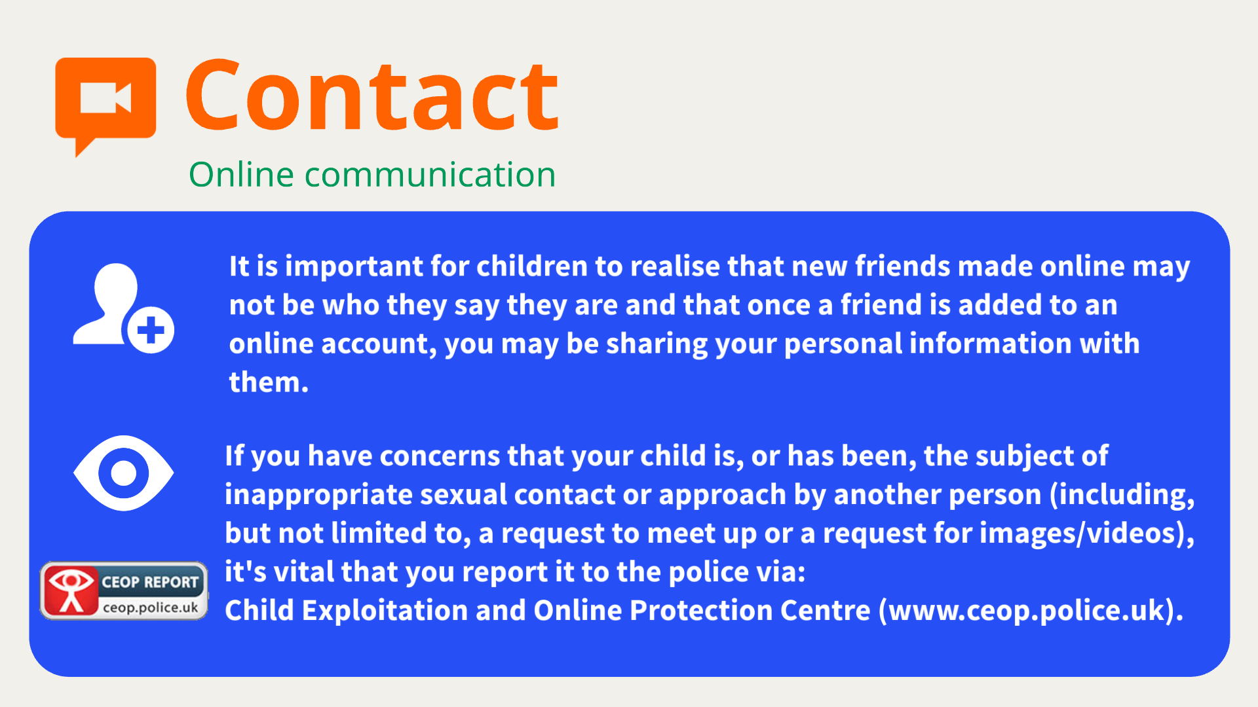

Slide 8
Advice

Slide 9
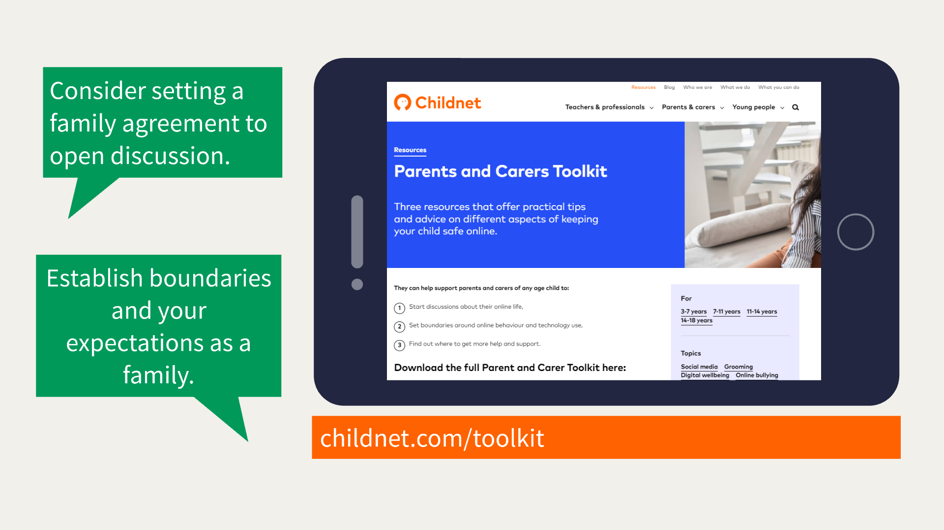

Slide 10
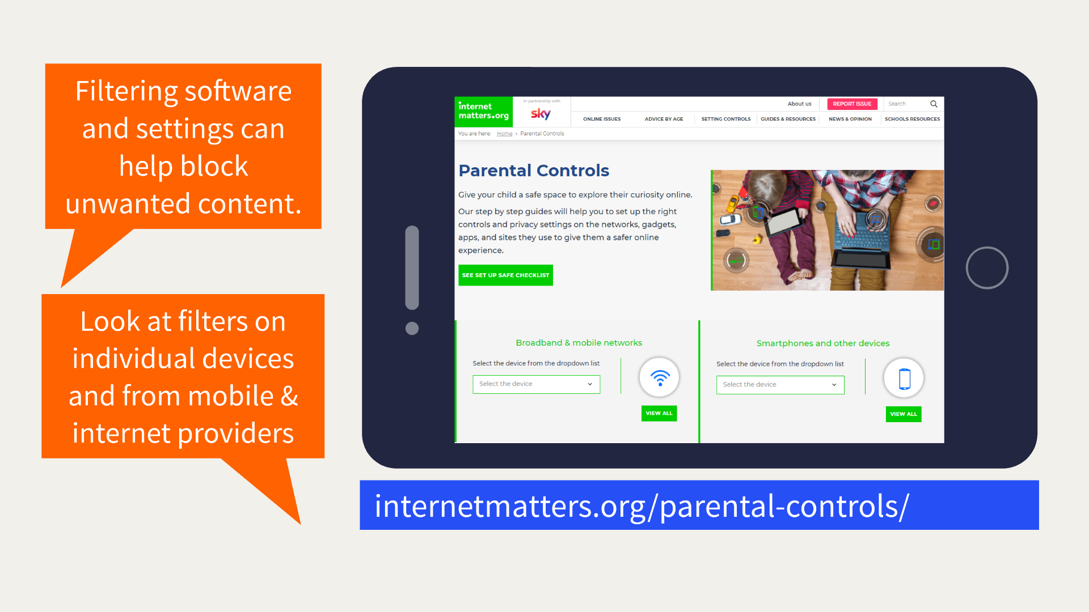

Slide 11
Parental Controls
  Family Link - Google
  Apple parent controls
  Microsoft family safety
  Internet provider
  Individual device settings
  Streaming services
  Apps and games

Slide 12
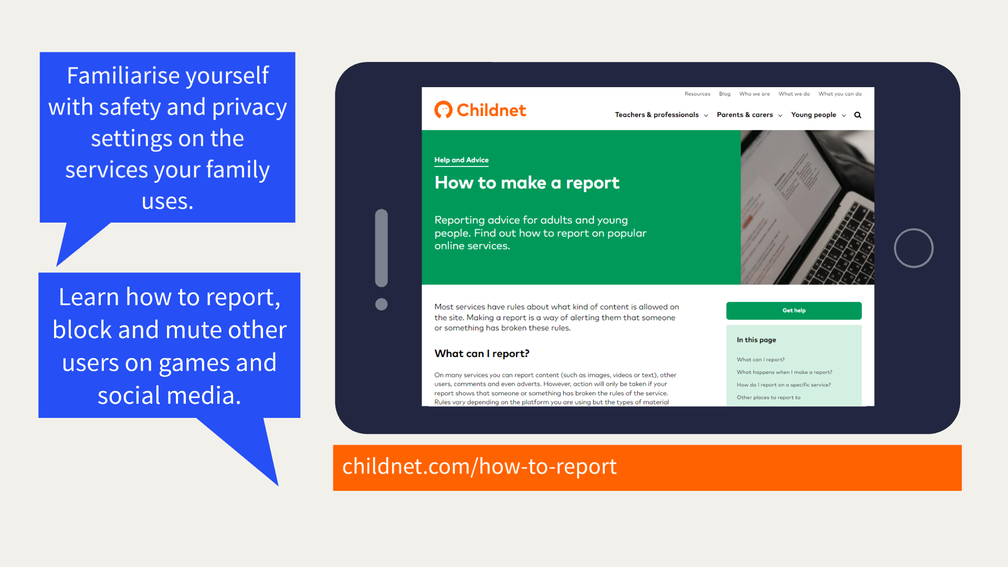

Slide 13
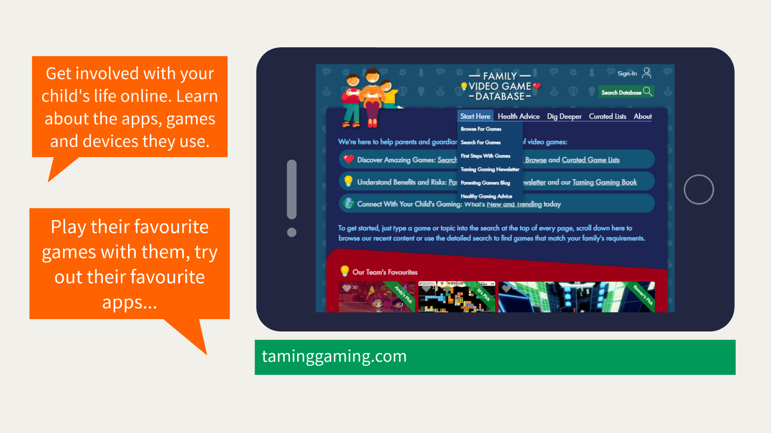

Slide 14
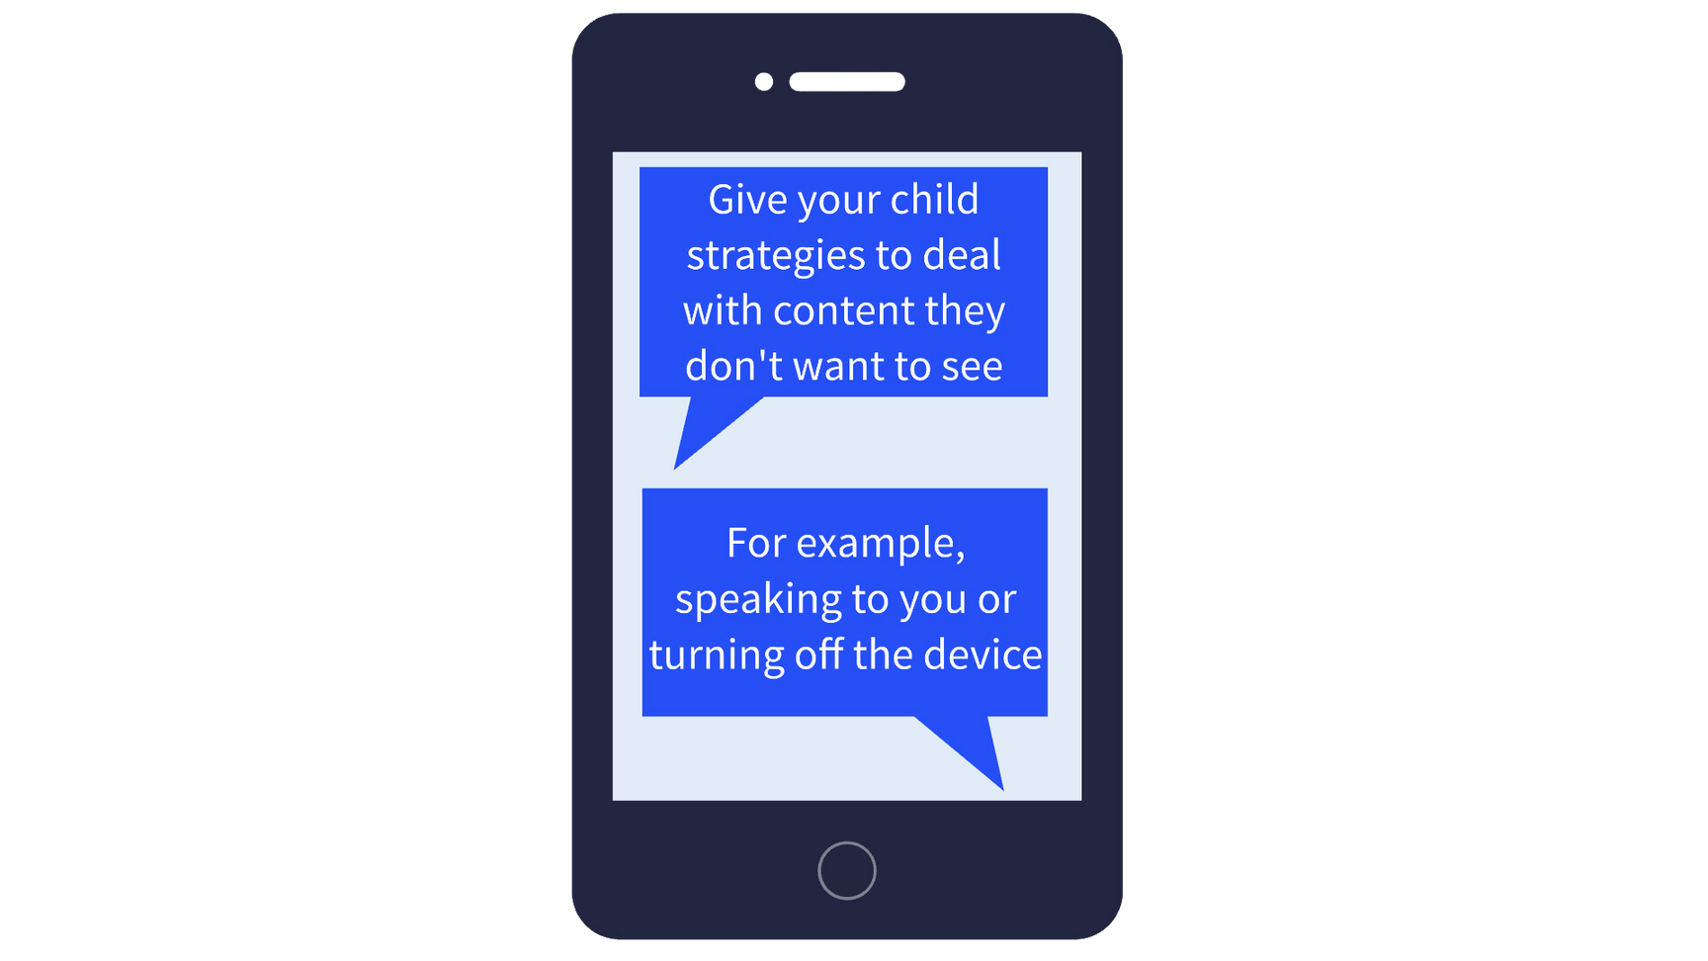
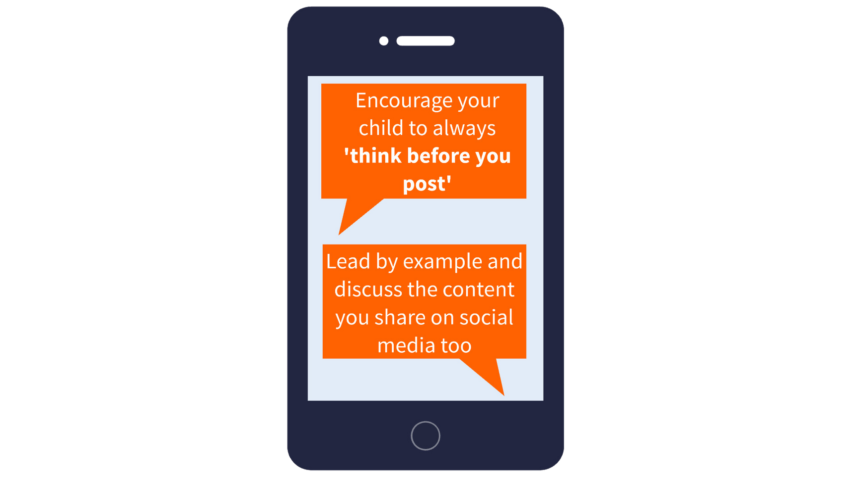
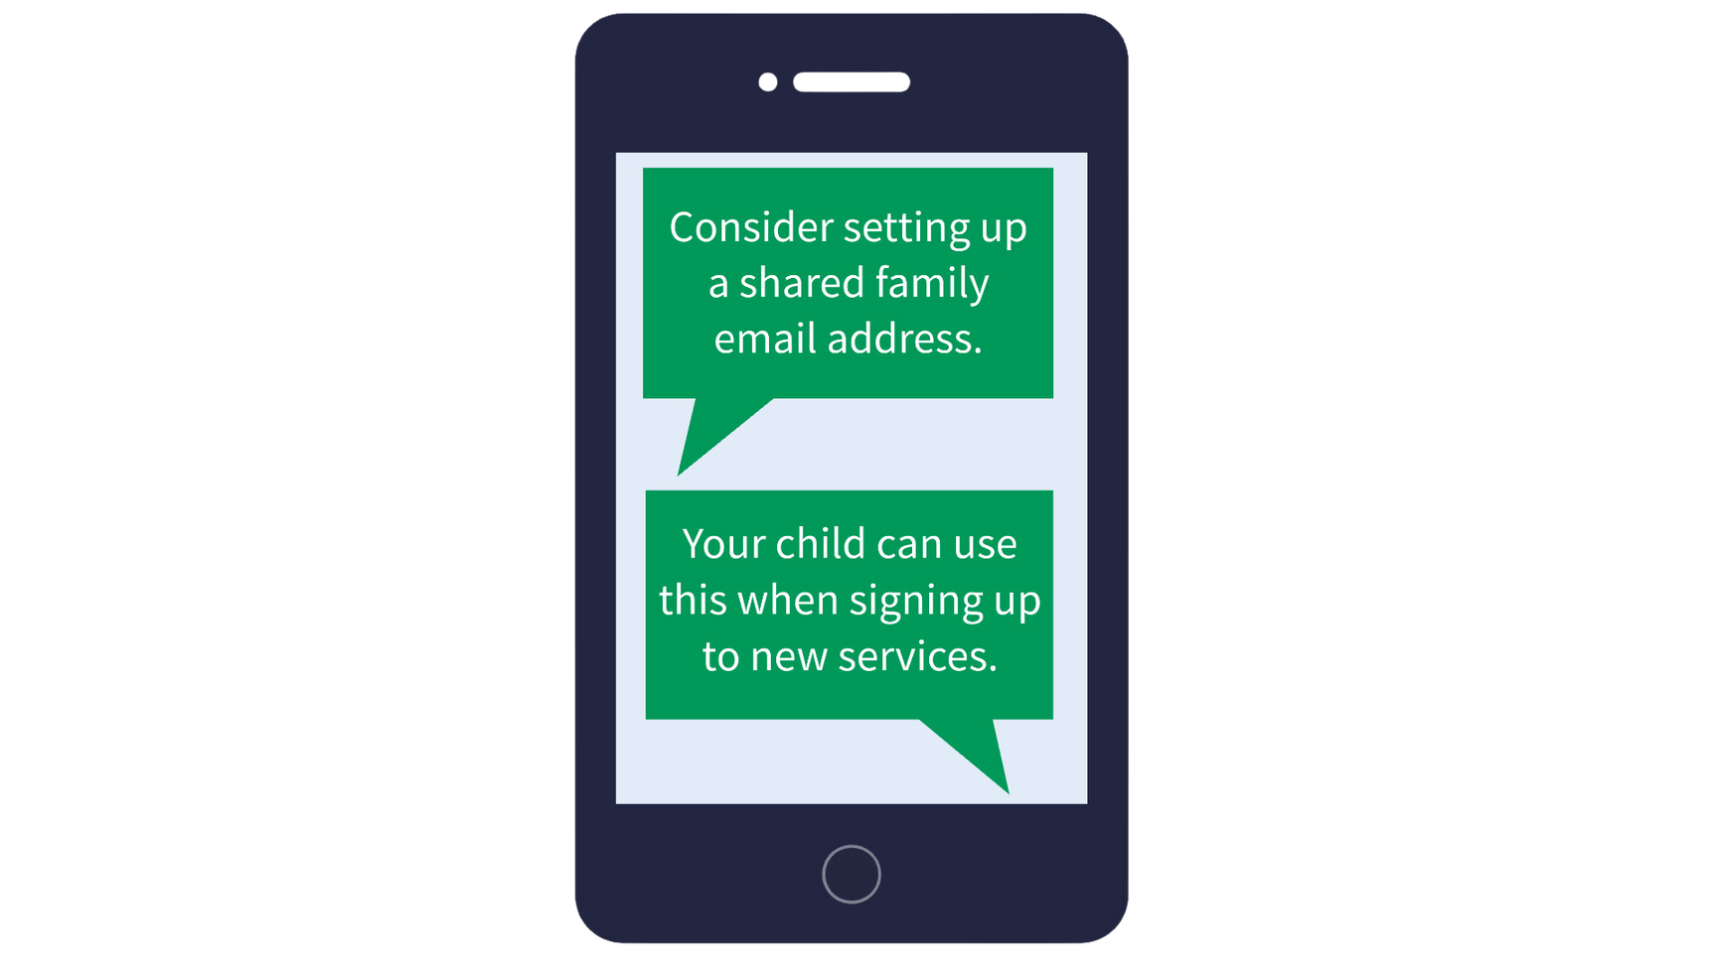

Slide 15
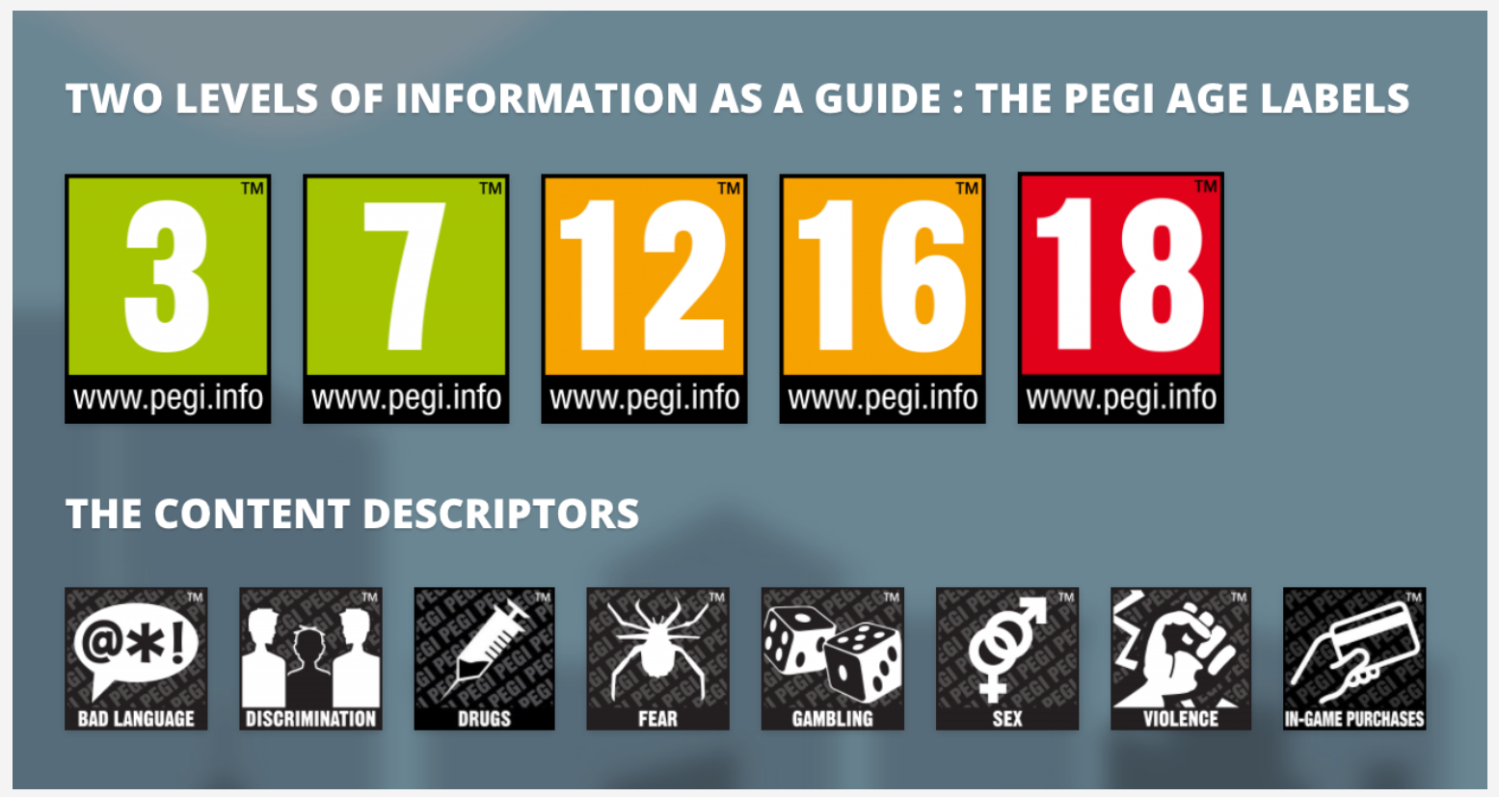
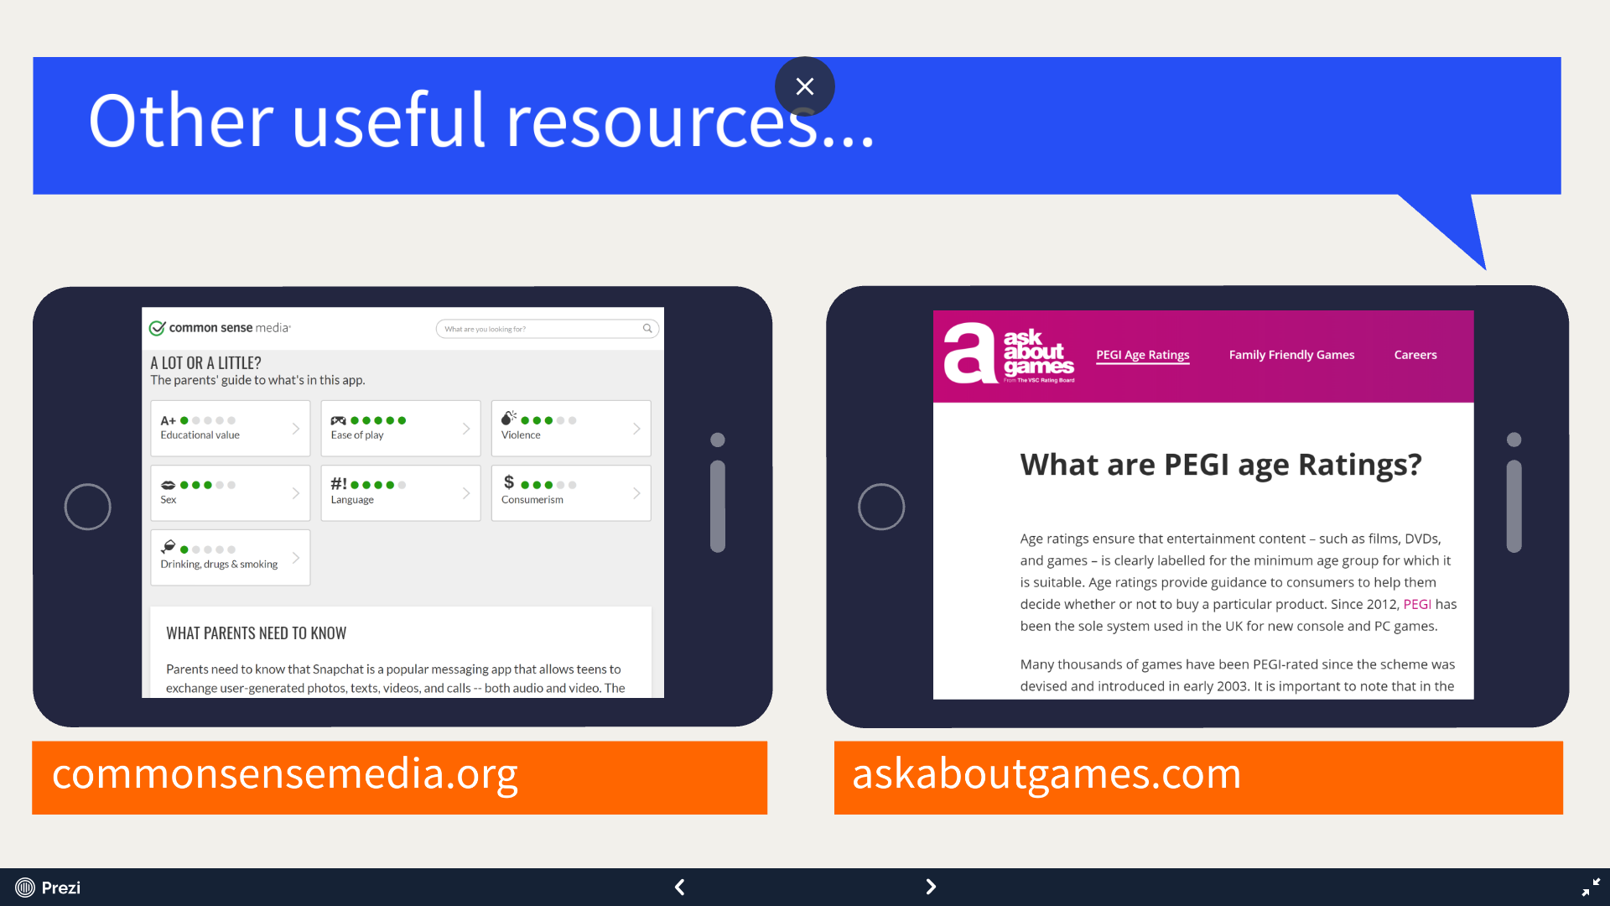

Slide 16
Social media
Social media sites have a minimum age of 13 or older.
This is due to data protection laws.
https://www.thinkuknow.co.uk/parents/articles/is-my-child-ready-for-social-media

Slide 17
Online Safeguarding Lessons
Children have regular Online Safeguarding lessons as part of computing and PD. We use Project Evolve Resources.
We have filtering and monitoring on all devices.

Slide 18
Useful links
taminggaming.com
askaboutgames.com
https://saferinternet.org.uk/
https://www.internetmatters.org/

